Slide 1


EAIT
PRESENTATION TEMPLATE
Ryan Rumsey
February 2017

Slide 2

BEFORE YOU BEGIN: OPENING
Here’s some advice:
START WITH THIS SLIDE
Making your presentation clean, clear, & simple
This template is found if you CLICK “ADD SLIDE” > CLICK THE IMAGE OF TITLE SLIDE
CHOOSE A CONSISTENT STYLE
01
Use the default Title and Body tags
Add your title and use 48 BOLD Open Sans
Add your subtitle and use 32 REGULAR Open Sans
Add your name/date and use 15 REGULAR Open Sans
02
Use an image if desired. Ideally this image is consistent with all other presentations from your org.
03
Add your organization logo in the bottom right of the master slides

Slide 3

BEFORE YOU BEGIN: ENDING
Here’s some advice:
END WITH THIS SLIDE
Making your presentation clean, clear, & simple
This template is found if you CLICK “ADD SLIDE” > CLICK IMAGE OF END SLIDE
01
PROVIDE CONTACT INFORMATION AS AN EFFECTIVE WAY FOR VIEWERS TO REACH OUT
ADD YOU NAME/TITLE/EMAIL ADDRESS AND USE 18 REGULAR Open Sans
02
ADD A CLOSING MESSAGE. IT’S FRIENDLY AND EFFECTIVE IN COMMUNICATION THE PRESENTATION IS FINISHED.

Slide 4
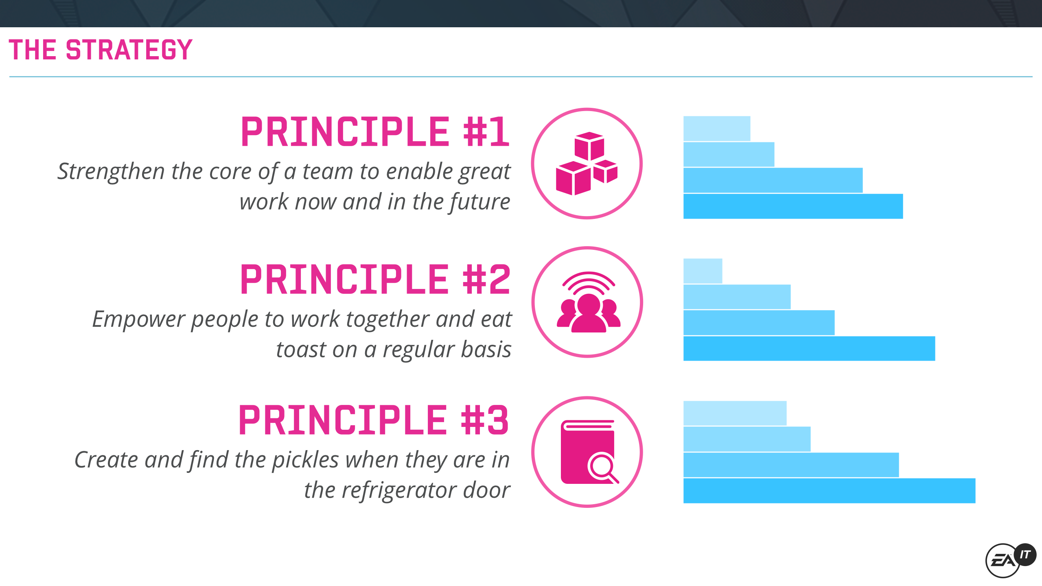
BEFORE YOU BEGIN: CONSISTENCY
Here’s some advice:
CHOOSE A CONSISTENT STYLE
Making your presentation clean, clear, & simple
03
USE CONSISTENT COLORS ACROSS THE PRESENTATION.
IDEALLY YOU HAVE A PRIMARY AND SECONDARY COLOR, WITH DARK GREY USED FOR SUPPLEMENTARY TEXT.
01
FOR HEADINGS, USE 30 BOLD Open Sans
02
USE THE SAME FONT AND FONT SIZES.
ONLY USE BOLD FOR KEY WORDS
04
KEEP TO ONE KEY MESSAGE PER SLIDE AND DON’T BE AFRAID OF WHITE SPACE

Slide 5
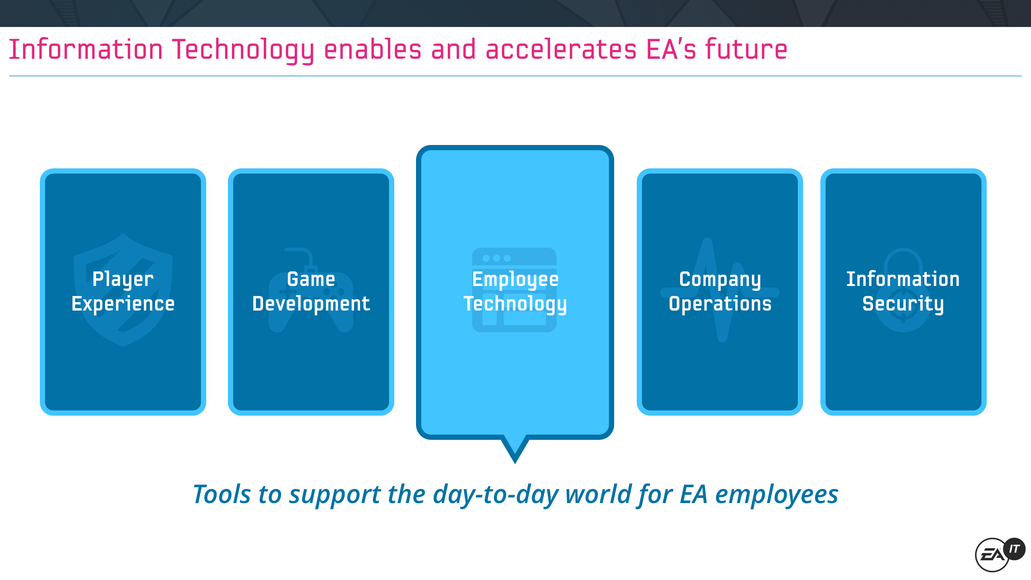
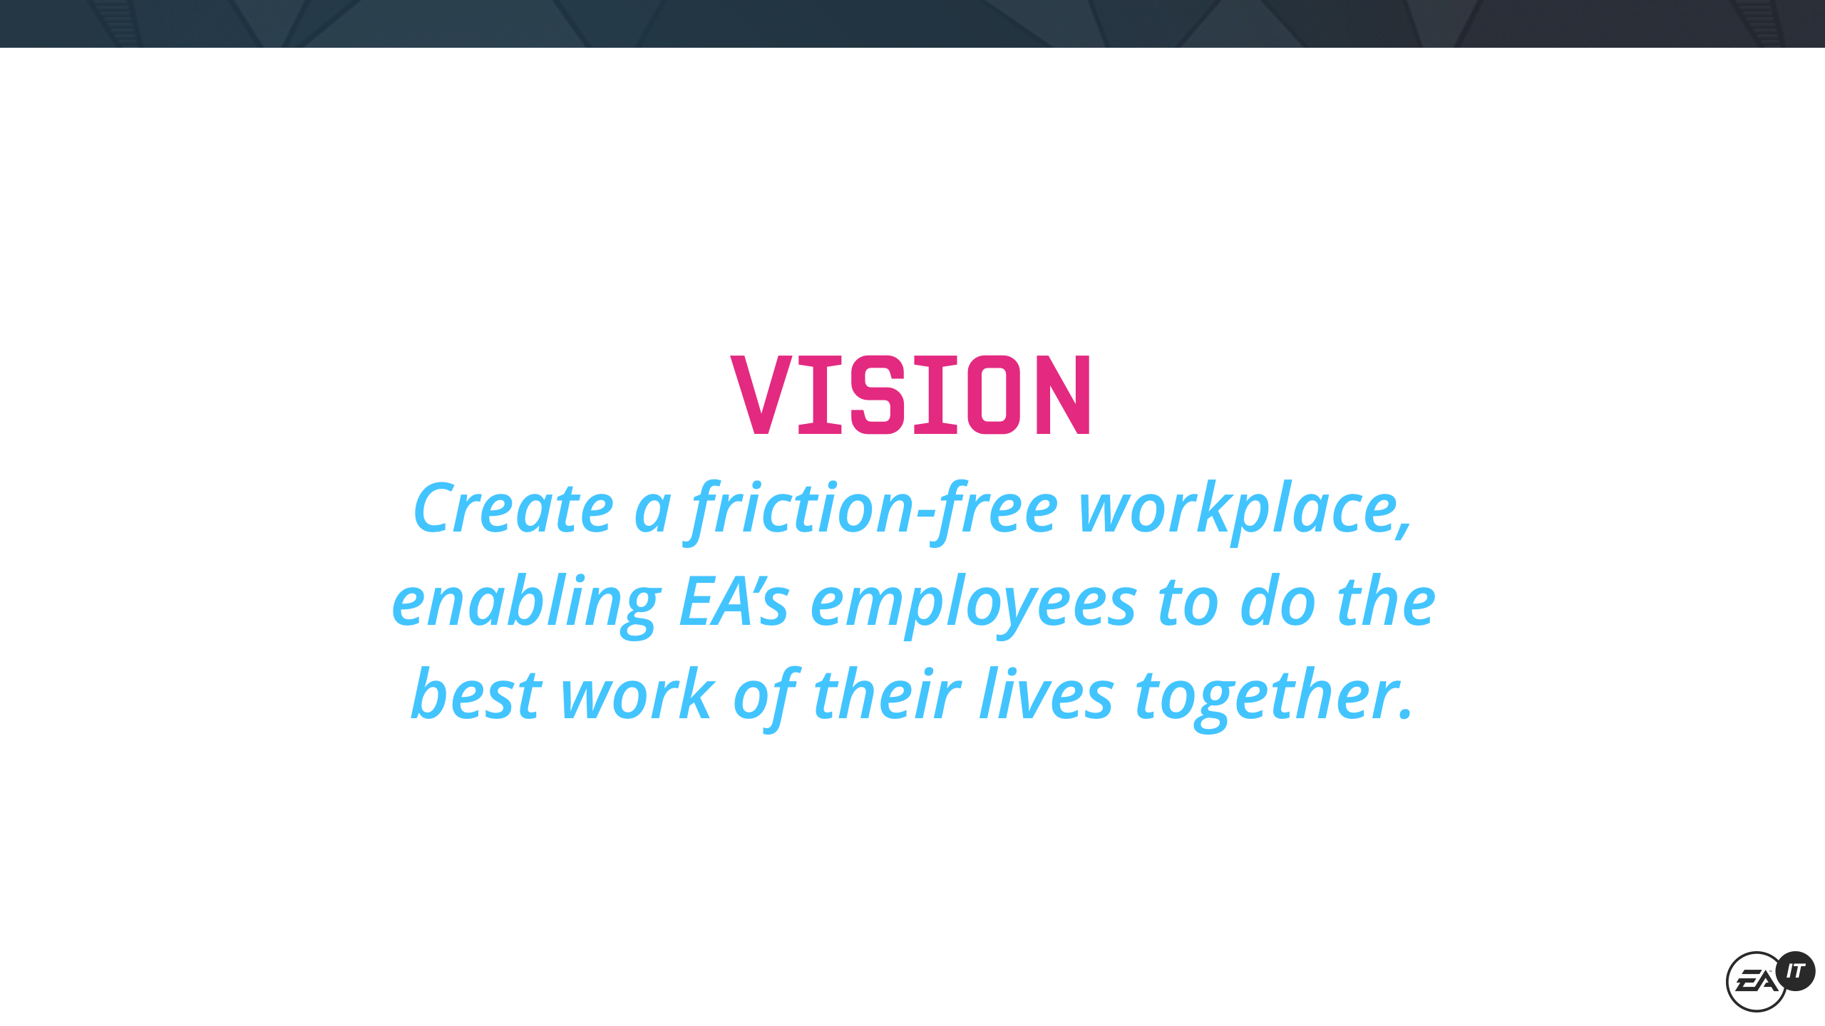
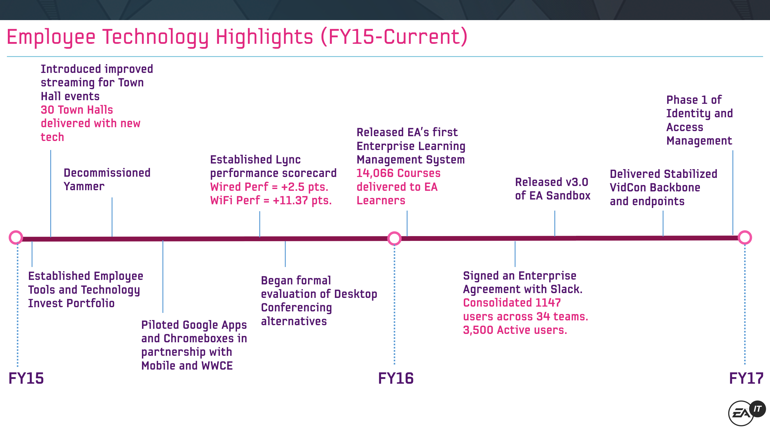
BEFORE YOU BEGIN: USE MASTER SLIDES
Here’s some advice:
A RANGE OF TEMPLATES WITH MASTER SLIDES
Making your presentation clean, clear, & simple
Use Master Slides to create reusable templates and layouts

Slide 6

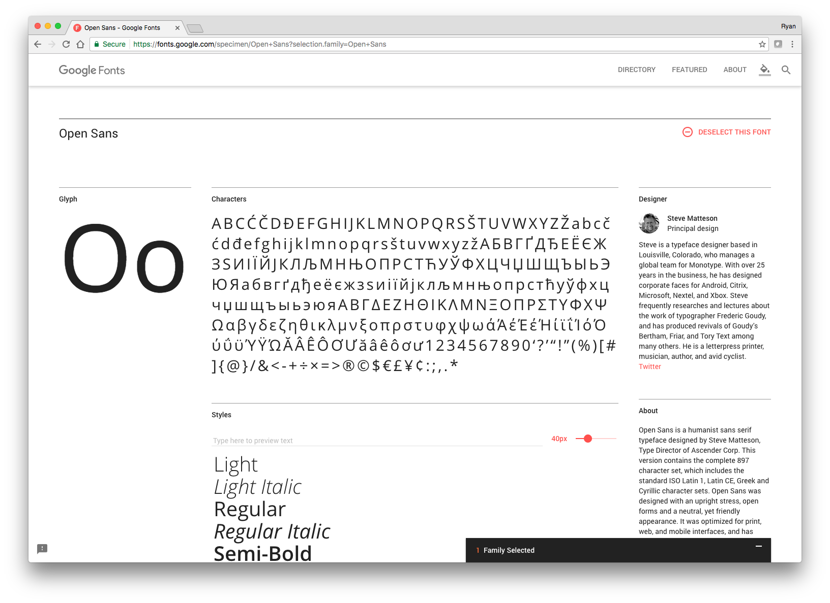
FONTS
This presentation leverages Open Sans
OPEN SANS IS AN OPEN SOURCE TYPEFACE. Open Sans was designed with an upright stress, open forms and a neutral, yet friendly appearance. It was optimized for print, web, and mobile interfaces, and has excellent legibility characteristics in its letterforms.
CAPITALIZATION
A good rule of thumb is, capitalize headings and page titles, then use lowercase for all descriptive text.
DOWNLOAD

Slide 7
COLORS
Colors are defined via the base colors of EAIT’s design system, Joystick.
These basic colors can be used to establish extended variations or themes inside your presentations.
PRIMARY COLOR
Choose one primary color to be the key highlight color throughout your presentation. This color should be used for your most important text.
SECONDARY COLOR
Select a secondary color for alternate highlights
DEFAULT COLOR
For all additional text, use the GREY COLOR OF #191919.
MINT
#E21B4F
PINE
#F17A2F
SKY
#F1D40A
BLUEBONNET
#24DC89
BERRY
#24DCC9
PLUM
#42C4FF
RASPBERRY
#4260FF
CHERRY (ERROR)
#A01BE2
TANGERINE (WARNING)
#E21B93
LIME (SUCCESS)
#FF83E1

Slide 8
IF YOU HAVE MULTIPLE SECTIONS, USE
DIVIDERS
TO BREAK UP THE PRESENTATION

Slide 9
Section Titles
Section titles are another great way to separate content or transition from one subject area to another

Slide 10
MAINTAINING ASPECT RATIO
Basic steps to maintain the aspect ratio of shapes
THE SHIFT KEY
When changing the shape of a shape, hold the shift key while changing the size to maintain the original aspect ratio.

Slide 11

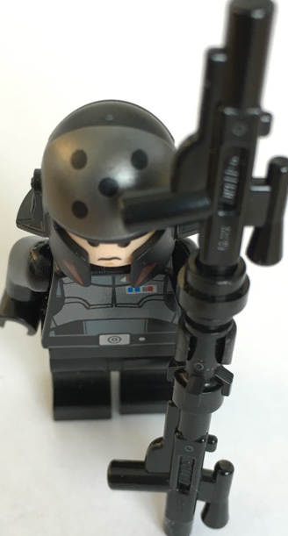
YOU CAN HAVE THE PERFECT IMAGE
All you need is a camera phone, a white piece of paper, and the know how
01 - Take your picture
Lay a piece of white paper on a desk. Arrange the object on the paper. Take a photo with your camera phone.
02 - Email
Send the photo to your work email address.
03 - Open image in Keynote or PPT
Adjust the Alpha Channel or Brightness and Contrast to “remove” the white background. Crop where necessary.

Slide 12


IMAGE QUALITY
Only designers have great images, right?
TOO MANY PRESENTATIONS ARE USING POOR OR “MAKE DO” IMAGES
High quality images are available to everyone. Remember, a picture speaks a thousand words. Make it count.
GO BIG!
One large image is much more powerful than five small, blurry images. Select a larger image, then size down to avoid blurs.
IMAGE RESIZING, SHIFT!
Remember your aspect ratios! Resizing the image while holding down the Shift key will cut down on the squashing or elongating of images.
SMALL IMAGES DO NOT SCALE!

Slide 13
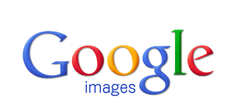
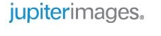
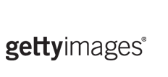
IMAGE SOURCING
Only designers have great images, right?
WHERE DO I FIND GOOD IMAGES?
gettyimages.com, jupiterimages.com, Google Images (with quality settings defined)
TAKE A PHOTOGRAPH
If you can’t find the image your’e looking for, take one! It’s a more efficient use of time to get exactly what you’re looking for, as opposed to trawling the internet for the perfect picture.
PNGs OR GIFs BEFORE JPGS
When searching for images, try to find images with transparent backgrounds. By searching for PNG of GIF files, your results will improve.

Slide 14
Thank you
  Ryan Rumsey
  Director, Experience Design, EAIT
  rrumsey@ea.com

